Slide 1
Search and problem solving
Mr. Ali Haider
Lab Instructor
Institute of Management Sciences, Peshawar.

Slide 2

Search in practice: getting from A to B
Imagine you’re in a foreign city, at some address (say a hotel) and want to use public transport to get to another address (a nice restaurant, perhaps).
What do you do? If you are like many people, you pull out your smartphone, type in the destination and start following the instructions.

Slide 3
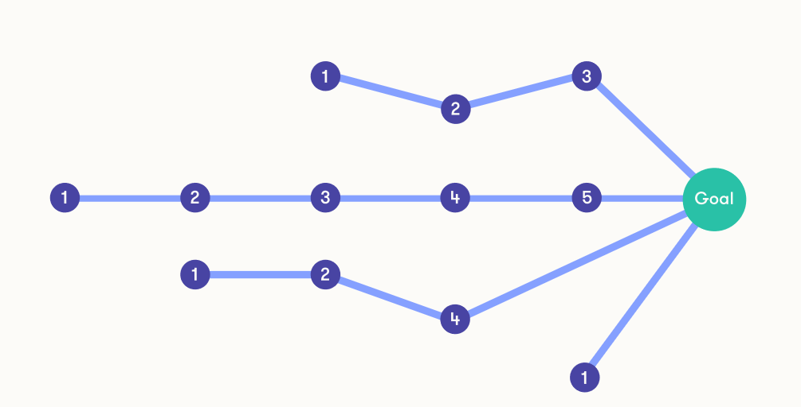
Search in practice: getting from A to B
This question belongs to the class of search and planning problems. Similar problems need to be solved by self-driving cars, and (perhaps less obviously) AI for playing games.
Often there are many different ways to solve the problem, some of which may be more preferable in terms of time, effort, cost or other criteria.
Different search techniques may lead to different solutions, and developing advanced search algorithms is an established research area.

Slide 4

Toy problem: chicken crossing
We’ll start from a simple puzzle to illustrate the ideas.
A robot on a rowboat needs to move three pieces of cargo across a river: a fox, a chicken, and a sack of chicken-feed.
The fox will eat the chicken if it has the chance, and the chicken will eat the chicken-feed if it has the chance, and neither is a desirable outcome.
The robot is capable of keeping the animals from doing harm when it is near them, but only the robot can operate the rowboat and only two of the pieces of cargo can fit on the rowboat together with the robot.
How can the robot move all of its cargo to the opposite bank of the river?

Slide 5
chicken crossing
We will model the puzzle by noting that five movable things have been identified:
the robot, the rowboat, the fox, the chicken, and the chicken-feed.
In principle, each of the five can be on either side of the river, but since only the robot can operate the rowboat, the two will always be on the same side.
Thus there are four things with two possible positions for each, which makes for sixteen combinations, which we will call states:

Slide 6
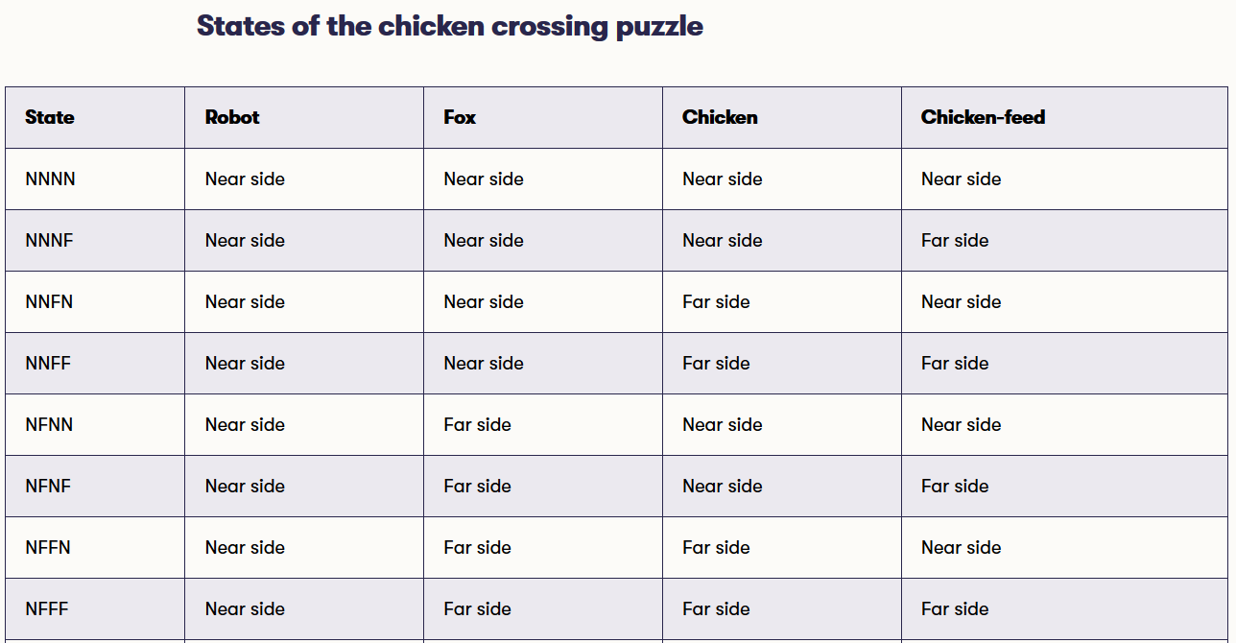
chicken crossing

Slide 7
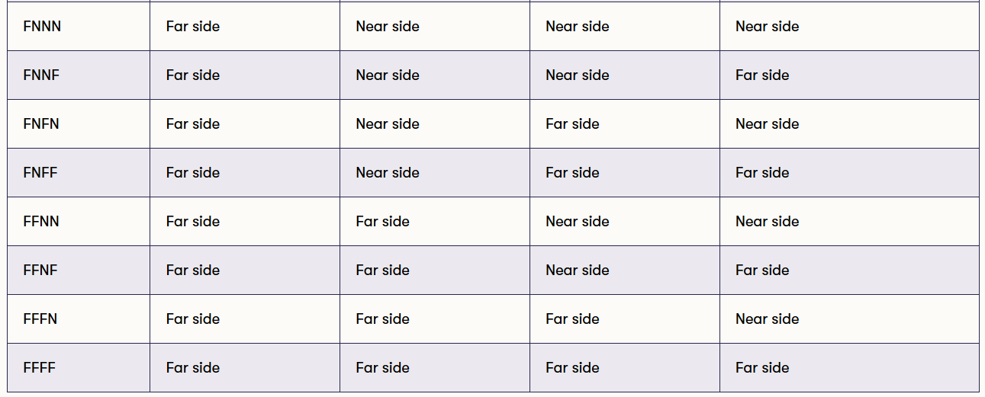
chicken crossing

Slide 8
chicken crossing
We have given short names to the states, because otherwise it would be cumbersome to talk about them.
Now we can say that the starting state is NNNN and the goal state is FFFF, instead of something like “in the starting state, the robot is on the near side, the fox is on the near side, the chicken is on the near side, and also the chicken-feed is on the near side, and in the goal state the robot is on the far side”, and so on.

Slide 9
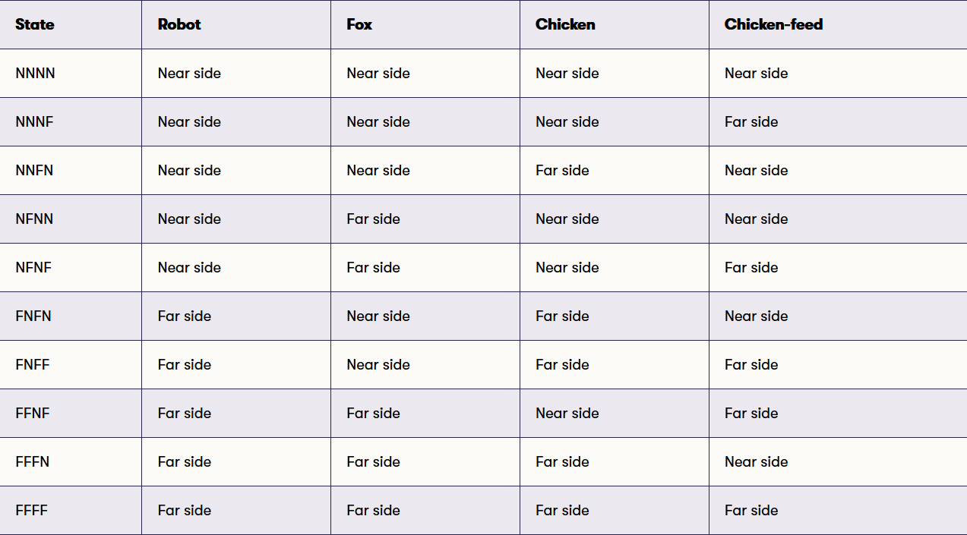
chicken crossing
Some of these states are forbidden by the puzzle conditions. For example, in state NFFN (meaning that the robot is on the near side with the chicken-feed but the fox and the chicken are on the far side), the fox will eat the chicken, which we cannot have.
Thus we can rule out states NFFN, NFFF, FNNF, FNNN, NNFF, and FFNN (you can check each one if you doubt our reasoning).
We are left with the following ten states:

Slide 10
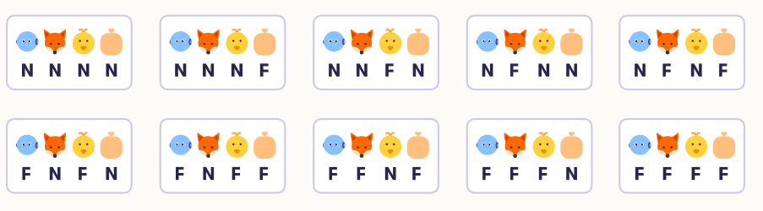
chicken crossing
Next we will figure out which state transitions are possible, meaning simply that as the robot rows the boat with some of the items as cargo, what the resulting state is in each case.
It’s best to draw a diagram of the transitions, and since in any transition the first letter alternates between N and F, it is convenient to draw the states starting with N (so the robot is on the near side) in one row and the states starting with F in another row:

Slide 11
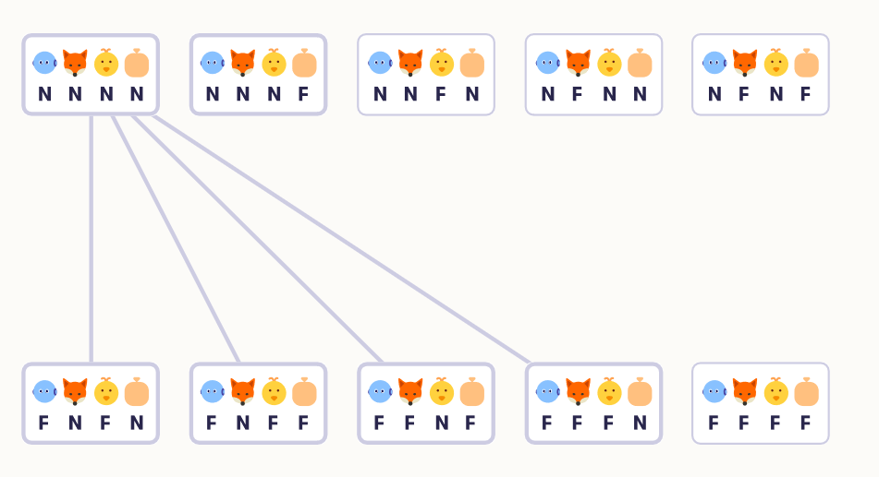
chicken crossing
Now let's draw the transitions.
We could draw arrows that have a direction so that they point from one node to another, but in this puzzle the transitions are symmetric: if the robot can row from state NNNN to state FNFF, it can equally well row the other way from FNFF to NNNN.
Thus it is simpler to draw the transitions simply with lines that don't have a direction. Starting from NNNN, we can go to FNFN, FNFF, FFNF, and FFFN:

Slide 12
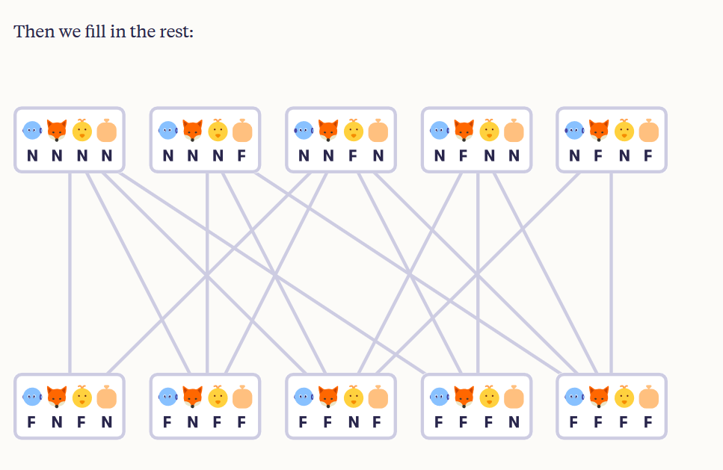
chicken crossing

Slide 13
chicken crossing
We have now done quite a bit of work on the puzzle without seeming any closer to the solution, and there is little doubt that you could have solved the whole puzzle already by using your “natural intelligence”.
But for more complex problems, where the number of possible solutions grows in the thousands and in the millions, our systematic or mechanical approach will shine since the hard part will be suitable for a simple computer to do.
Now that we have formulated the alternative states and transitions between them, the rest becomes a mechanical task: find a path from the initial state NNNN to the final state FFFF.

Slide 14
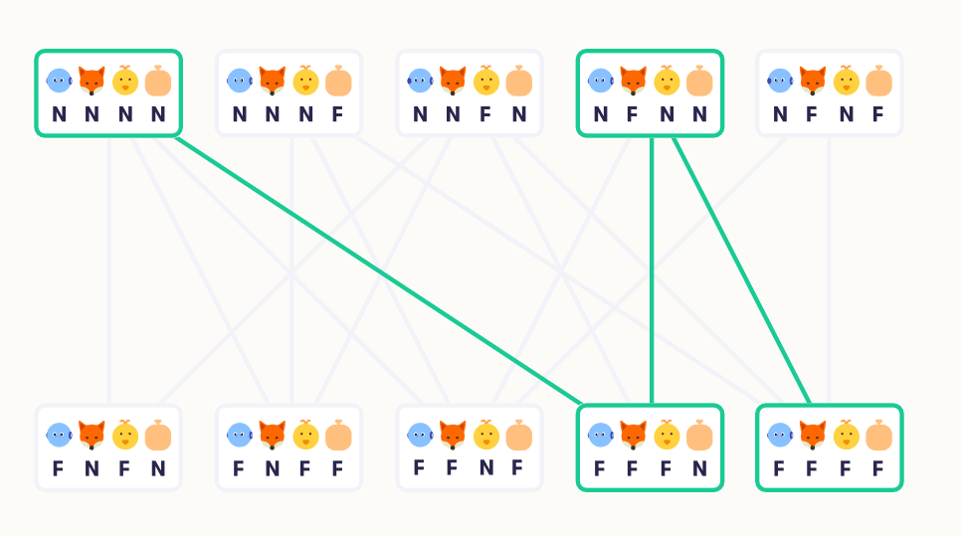
chicken crossing
One such path is colored in the following picture. The path proceeds from NNNN to FFFN (the robot takes the fox and the chicken to the other side), thence to NFNN (the robot takes the chicken back on the starting side) and finally to FFFF (the robot can now move the chicken and the chicken-feed to the other side).

Slide 15
State space, transitions, and costs
To formalize a planning problem, we use concepts such as the state space, transitions, and costs.
The state space means the set of possible situations.
In the chicken-crossing puzzle, the state space consisted of ten allowed states NNNN through to FFFF (but not for example NFFF, which the puzzle rules don´t allow).
If the task is to navigate from place A to place B, the state space could be the set of locations defined by their (x,y) coordinates that can be reached from the starting point A.

Slide 16
State space, transitions, and costs
Transitions are possible moves between one state and another, such as NNNN to FNFN.
It is important to note that we only count direct transitions that can be accomplished with a single action as transitions.
A sequence of multiple transitions, for example, from A to C, from C to D, and from D to B (the goal), is a path rather than a transition.

Slide 17
State space, transitions, and costs
Costs refer to the fact that, oftentimes the different transitions aren´t all alike.
They can differ in ways that make some transitions more preferable or cheaper (in a not necessarily monetary sense of the word) and others more costly.
We can express this by associating with each transition a certain cost.
If the goal is to minimize the total distance traveled, then a natural cost is the geographical distance between states.
On the other hand, the goal could actually be to minimize the time instead of the distance, in which case the natural cost would obviously be the time. If all the transitions are equal, then we can ignore the costs.

Slide 18
References and Materials
https://course.elementsofai.com/2/1

